Slide 1

Last orders

Slide 2
Team composition recap
Jon – Project manager
Morgan – Technical director
Harrison – User experience guru
Experience with 3d games in unity
Proficient in C#
In-depth knowledge of gameplay systems
Very experienced with unity
Proficient in C#
Great qualitative and quantitative data analysis skills
Full stack developer

Slide 3
Problem domain
Problem
Lack of skill-based systems that reward precision/timing
No meaningful feedback loop (like reputation) tied to performance
Limited player feedback, making it unclear how well the player is performing
Solution:
Implemented a skill-based cocktail creation system (timing, selection, accuracy)
Introduce a dynamic reputation system that rewards/punishes player performance
Provide clear visual and audio feedback
Competitors
Overcooked!
Bartender Simulator

Slide 4
Last orders so far…
3D environment
Major game systems
Gameplay loop
Upgrades
Basic FX

Slide 5

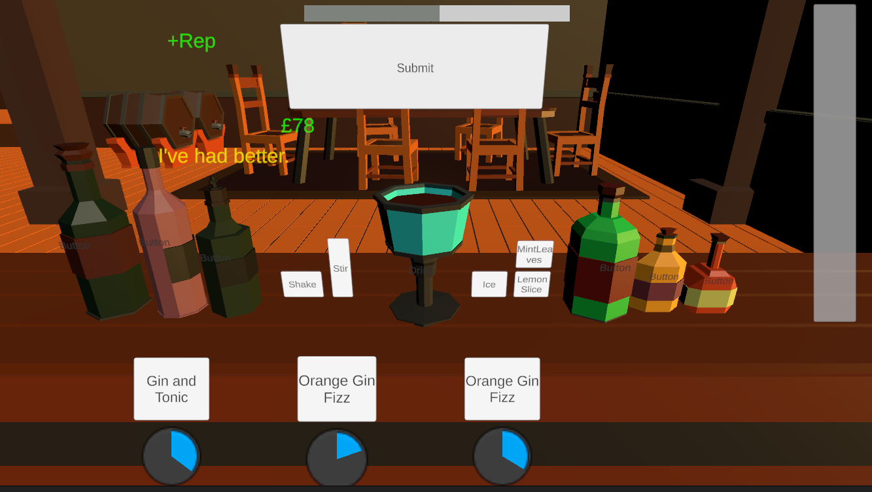
Last orders so far…

Slide 6
Team website

Slide 7
Features
MVP
MAP
Basic gameplay loop
Simple player interactions
5 drink recipes
9 total ingredients
Polished gameplay loop with progression
More advanced player interactions (shake/ stir)
10+ drink recipes
Interchangeable ingredients based off active recipes

Slide 8
Next steps
Basic reputation system
UI polish
More FX (mainly sound)
More advanced progression system

Slide 9
Thanks Any questions?

